Slide 1

COIS 3320: Fundamentals of Operating Systems
Alaadin Addas
Week 11
I/O

Slide 2
Overview
Announcements/Reminders (Overview – Video 1)
Report Details (Video 1)
Recap (Overview - Video 1 )
I/O
The Hardware/Software Interface (Video 2)
Data Buffering & Scanning (Video 3)
Disk Scheduling (Video 4)

Slide 3
Announcements/Reminders
Assignment 3 is due by the 5th of April!
Project reports/presentations are due by the 9th of April
The standard late penalty does not apply for assignments due on the 9th, they must be completed and submitted by the 9th.
Please be sure to attend the lecture on the 9th of April we will be going over all the details required for the final.
The 5th lab is scheduled on the 9th of April.
It will also be due on the 9th of April.
It will not be a complex lab like Lab 3 and Lab4, it will be designed to be completed in an hour.

Slide 4
Report Details
The report must be 1200 words excluding references.
My report is 1199 words, will I lose points?
NO!
My report is 500 words, will I lose points?
Yes.
I don’t care about the reference format! Pick one and stick to it!
IEEE
MLA
APA
Sources must be reliable and reputable.
I don’t care about the formatting but please don’t submit anything under 12-point font!
Every statement of fact that you did not yourself find out or know must be cited. For example: 97% of all desktop computers utilize Windows 10, is a statement that needs to be cited.
No, it is not true.

Slide 5
Recap
Two weeks ago, we ended the lecture while talking about about File Systems.
We discussed several ways to organize directory structures:
Tree Structured Directory Hierarchy
Allows only one parent directory (bad)
Directed Acyclic Directory Structure
Allows more than one parent directory but can lead to unreachable directories and files (bad).
Graph Structure with Symbolic Links
Compromise solution, allows only one parent directory, but offers symbolic links (similar to shortcuts), to remedy the problem caused by tree structured directory hierarchies.

Slide 6
The Hardware/Software Interface
A general-purpose computer system contains I/O devices for human-computer interaction, for secondary storage, and for networking. Devices are attached to the system using controllers.
A device controller (device adapter) is an electronic circuit capable of operating a specific I/O device using binary signals.
The interface to a device controller is a set of hardware registers and flags, which may be set by and/or examined by device drivers.

Slide 7
The Hardware/Software Interface
A device driver is a device-specific program that implements I/O operations, requested by user applications or the OS, by interacting with the device controller.
Since devices vary greatly in speed, latency, and the size of data being transmitted, the ability to perform random vs sequential access, and other aspects, device drivers are supplied by the device manufacturers.

Slide 8
The Hardware/Software Interface
To be able to incorporate new devices into a system without modifications to the OS, the I/O system supports a small set of generic API instructions. The typical subdivision includes instructions for:
Block-oriented devices (magnetic disks, CD ROMs, FLASH disks)
Character-oriented devices (keyboards, pointing devices, cameras, media players, printers)
Network devices (modems, Ethernet adapters)
The driver of any new device must implement the generic I/O instructions of an API for the specific device.

Slide 9
Programmed I/O With Polling
A generic interface to a device controller consists of a set of registers:
Register | Use
Opcode | The register specifies the type of operation requested. Ex: read or write. Storing a new value into the register starts the I/O operation.
Operands | One or more operand registers are used to describe the parameters of the requested operation. The values are written by the CPU prior to starting the operation.
Busy | The register (a 1-bit flag) is set by the controller to indicate whether the device is busy or idle.
Status | The register is set by the controller to indicate the success or failure of the last I/O operation.
Data buffer | The data buffer holds the data to be transferred between the device and main memory. Depending on the device type, the buffer may hold a single character or a block of data.

Slide 10
Programmed I/O With polling
Programmed I/O is a style of I/O programming where the CPU, running the device driver, performs the copying of all data between the I/O device controller and main memory.
Polling is a technique to determine whether a device is busy or idle by reading a flag set and reset by the device controller.
To perform programmed input with polling, the CPU first issues an input request to the device controller by writing a new value into the opcode register.
Then the CPU repeatedly polls the busy flag until the operation completes. If the operation was successful, the CPU copies the data from the controller buffer to main memory.

Slide 11
Programmed I/O With Polling
Programmed output with polling is analogous. When the device is not busy, the CPU copies the data from main memory to the controller buffer and issues an output request.
The CPU then polls the busy flag until the operation completes. If the operation was successful, the CPU may proceed with the next output operation.

Slide 12
Programmed I/O With Interrupts
When interrupts are used for I/O processing, the interface to the controller remains the same, but the controller is equipped with the ability to issue interrupts to the CPU.
The operand and opcode registers are used to describe and start an I/O operation.
The status register indicates the success or failure of the last operation. The controller buffer holds the data transferred to or from the device.

Slide 13
Programmed I/O With Interrupts
The busy flag is still present but is used only initially to determine whether the device is available to accept a new I/O request.
Then, after starting the I/O operation, the current process blocks itself, instead of repeatedly polling the busy flag to detect the termination of the data transfer.
The controller issues an interrupt when the operation has terminated, which reactivates the blocked process.
The process examines the status of the operation and, depending on the outcome, proceeds with the next I/O operation or takes appropriate corrective actions.
Please run through participation activity 9.1.5: Programmed input with interrupts.

Slide 14
I/O With Direct Memory Access
With programmed I/O, the CPU needs to transfer all data between the controller buffer and the main memory.
The resulting overhead is acceptable with slow, character-oriented devices, but to liberate the CPU from the frequent disruptions caused by fast devices, direct memory access may be used.
A direct memory access (DMA) controller is a hardware component that allows devices to access main memory directly, without the involvement of the CPU.
Using DMA, the CPU only initiates a data transfer, which can consist of a line of characters, a block of data, or even multiple blocks of data, as part of a single I/O operation.

Slide 15
Polling V.S. Interrupts
Polling and interrupts both result in overhead during I/O processing but the sources of the overhead are different.
Executing a single poll requires only a few machine instructions.
On the other hand, blocking and later reactivating a process using an interrupt constitutes significant CPU overhead.
Polling is a good choice in dedicated systems, where only a single process is running.
The CPU can busy-wait by executing a polling loop because no other computation is available to use the CPU in the meantime.
Polling is also suitable for devices that complete an I/O operation within a few microseconds.
For example: non-volatile solid-state (flash) memories; with such very fast devices, a context switch using interrupts would be more time consuming than a short polling loop.

Slide 16
Polling V.S. Interrupts
In a general-purpose multi-process environment, interrupts are a better choice with most devices.
Blocking a process after issuing an I/O instruction and later processing the interrupt to reactivate the process represents constant, predictable overhead for each I/O instruction.
The device is restarted immediately after completing the data transfer and CPU time is never wasted on long busy-loops when a device is slow in responding.

Slide 17
Data Buffering & Caching
A buffer is a register or an area of main memory used to hold data generated by a producer process or an input device and removed from the buffer at a later time by a consumer process or an output device.
Depending on the intended use, a single buffer can hold one character at a time or a larger block of data.
The main purpose of using a single buffer is to decouple the producer from the consumer in time.
The producer can generate a data item without the consumer being active simultaneously. Similarly, the consumer can copy the item from the buffer without the producer being active simultaneously.
A buffer also permits the consumer to accumulate and act upon multiple data items generated by the producer one at a time.

Slide 18
Buffer Swapping
In a producer-consumer situation sharing a buffer, the consumer is blocked or idle while the producer is filling the buffer.
Similarly, the producer is blocked or idle while the consumer is copying the buffer.
Buffer swapping is a technique that allows the operations of a producer process and a consumer process to overlap by using two buffers.
While the producer is filling buffer 1, the consumer is copying buffer 2.
When both terminate, the two buffers are swapped.
The producer starts filling buffer 2 while the consumer starts copying buffer 1.

Slide 19
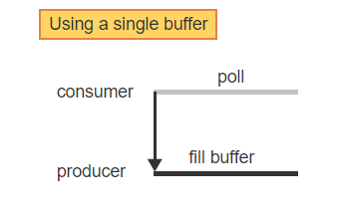
Single Buffer V.S. Buffer Swapping – 1
A producer and a consumer interact via a common buffer. The consumer repeatedly asks the producer to fill the buffer and waits for the completion by blocking itself or by polling the producer

Slide 20
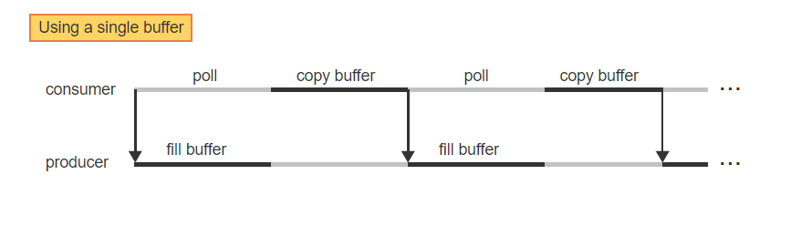
Single Buffer V.S. Buffer Swapping – 2
Whenever the producer terminates, the consumer copies the data buffer and starts the next operation of the producer

Slide 21
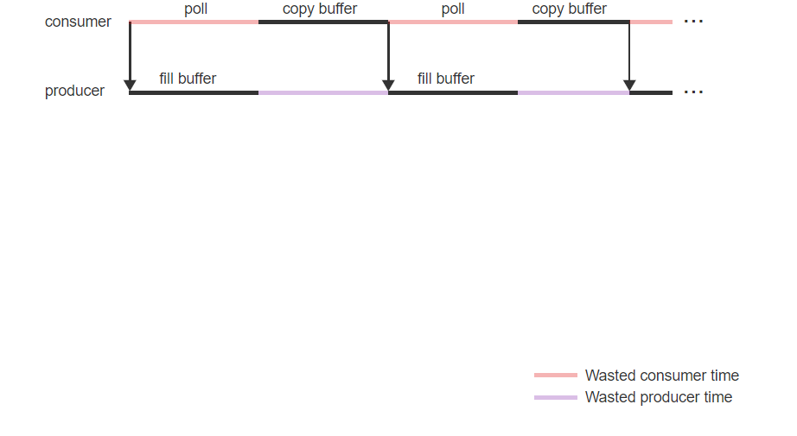
Single Buffer V.S. Buffer Swapping – 3
The consumer's time is wasted while the producer is busy and vice versa

Slide 22
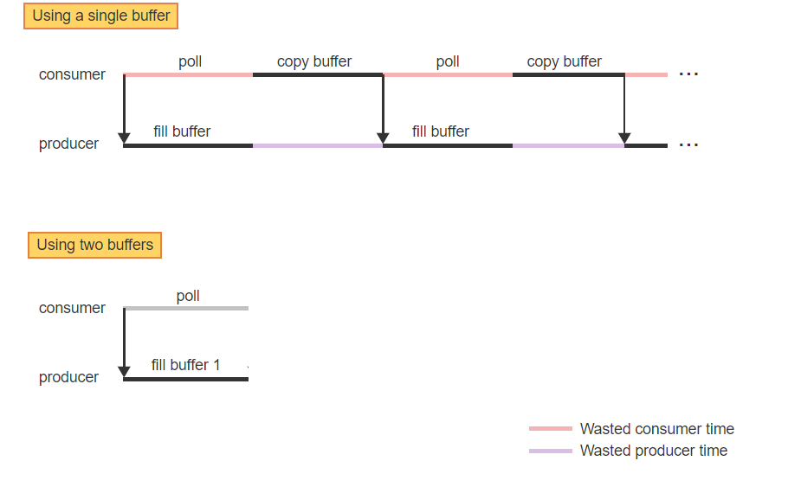
Single Buffer V.S. Buffer Swapping – 4
With buffer swapping, the producer is asked to initially fill buffer 1. The consumer is polling the producer during that time

Slide 23
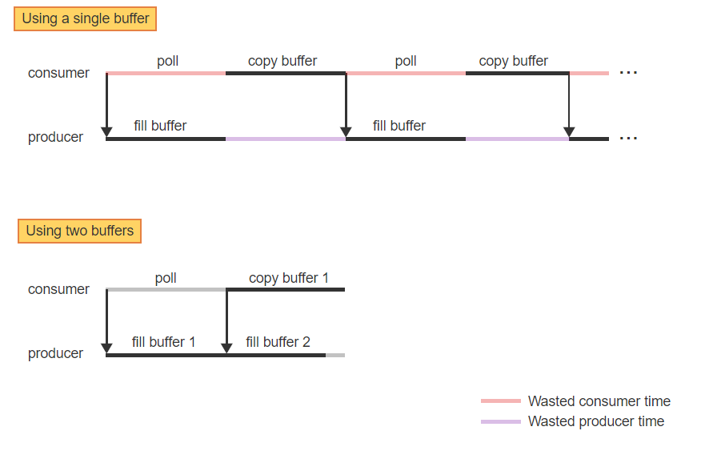
Single Buffer V.S. Buffer Swapping – 5
When buffer 1 is filled, the producer starts filling buffer 2, while the consumer is copying buffer 1

Slide 24
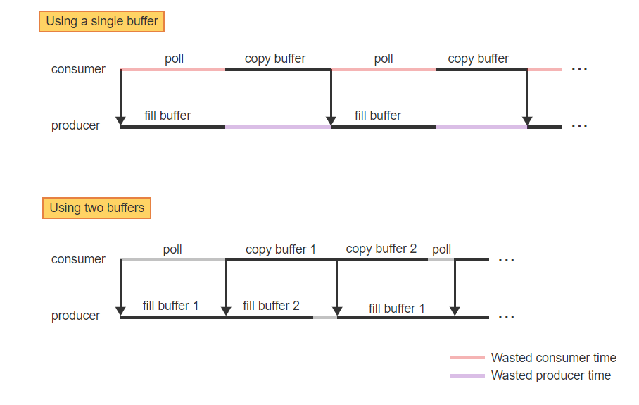
Single Buffer V.S. Buffer Swapping – 6
Whenever both terminate, the buffers are swapped. The producer starts filling buffer 1, while the consumer is copying buffer 2

Slide 25
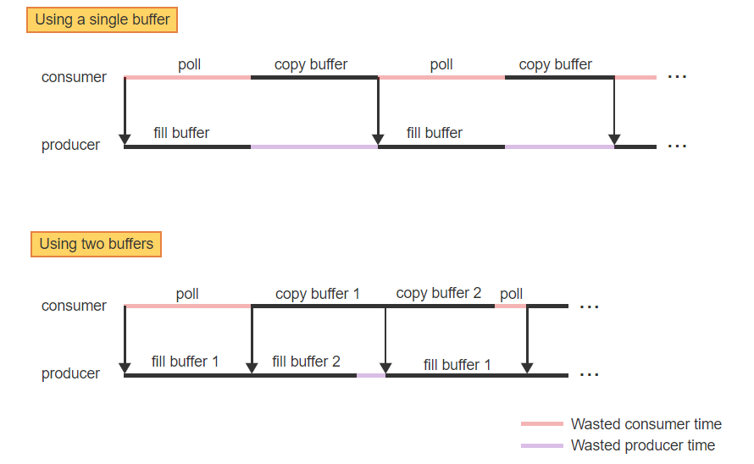
Single Buffer V.S. Buffer Swapping – 7
When the times to fill and copy different buffers overlap, the producer and the consumer run concurrently. Only minimal time is wasted on polling or producer idle time

Slide 26
Circular Buffer
Buffer swapping improves performance by overlapping the execution of the producer and the consumer, but only when data is produced and consumed at the same constant rate.
In situations where data is produced in bursts of varying lengths or frequency and the consumer is unable to handle the incoming data at the rate of a burst, multiple buffer slots are useful to hold and process the data at the slower rate of the consumer.
Conversely, if the consumer needs to process incoming data in bursts or at a higher granularity, then multiple buffer slots can be used to accumulate the data prior to each burst.

Slide 27
Circular Buffer
A circular buffer is a fixed array of buffer slots filled by the producer and emptied by the consumer one slot at a time in ascending order, modulo the buffer size.

Slide 28
Disk Block Caching
To speed up access to disk blocks, modern disk controllers include an internal cache to hold the most recently accessed blocks.
In addition, the OS may maintain an additional larger cache in main memory. A disk block cache is a set of main memory buffers that contain the most recently accessed disk blocks.

Slide 29
Disk Block Caching
Since a disk block cache can contain a large number of blocks, hashing is used to organize blocks into separate lists for faster access. In addition, all blocks are divided into several categories and are linked together using separate linked lists.
Blocks critical to performance (Ex: blocks used internally by the OS) must remain resident at all times and are kept on a list of Locked blocks.
Blocks expected to be accessed again in the near future (Ex: blocks holding data from regular user files) reside on a list that implements the LRU (least recently used) policy.
Whenever a block is accessed, the block is moved to the rear of the list. Blocks not accessed again gradually migrate to the front of the list and are removed when no free buffers are available.
Blocks expected to be accessed only once or very infrequently (Ex: blocks containing file control blocks, which are accessed when a new file is opened) are added to the front of the same LRU list and thus will be removed quickly.

Slide 30
Disk Block Caching
All free buffers are kept on a separate list, possibly segregated by buffer size, and are added to the Locked list or the LRU list whenever a new non-resident block is accessed.

Slide 31
Disk – Review
Track: A track is one of many concentric rings on a magnetic disk surface.
Sector: A sector is a portion of a track and is the smallest unit of data that can be read or written with a single r/w operation.
Seek Time: The seek time is the time to move the r/w head from the current position to the track containing the desired data.
Rotational Delay: The rotational delay (rotational latency) is the time to wait for the desired data item to pass under the r/w head.
Rotational Latency: The rotational delay (rotational latency) is the time to wait for the desired data item to pass under the r/w head.

Slide 32
Disk – Review
Data Transfer Time: The data transfer time is the time to transfer the desired number of bits to or from the disk, and is directly proportional to the disk's rotational speed.
Peak Transfer Rate: Peak transfer rate is the rate at which the data is streamed to or from the disk once the read/write head is at the beginning of the sector to be transferred.
Sustained Data Rate: Sustained data rate is the rate at which the disk can transfer data continuously.

Slide 33
Disk Scheduling - SSTF
The Shortest seek time first (SSTF) scheduling algorithm considers the list of all pending requests and always selects the request that requires the shortest travel distance from the current position.

Slide 34
Disk Scheduling – Scan Scheduling
The Scan scheduling algorithm mimics the behavior of an elevator in a building.
The r/w head maintains a current direction of travel and services all request sequentially in the current direction
When the outermost request is reached, the direction is reversed, and the algorithm services all requests in the opposite direction.

Slide 35
Disk Scheduling – C Scan Scheduling
The C-Scan scheduling algorithm is a variant of the Scan algorithm that services requests in only one direction.
When the outermost request is reached, the r/w head sweeps back to the opposite end of the disk and starts servicing requests again in the same direction.

Slide 36
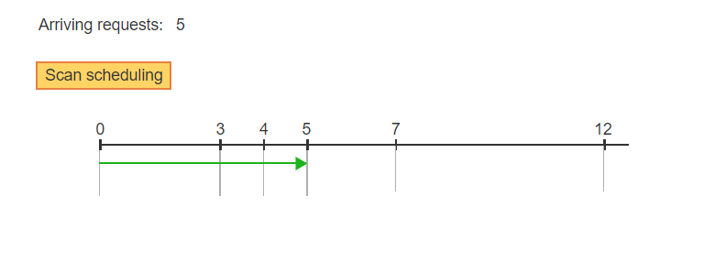
C Scan V.S. Scan Disk Scheduling – 1
The r/w head moves from track 0 to track 5 to service the first request

Slide 37
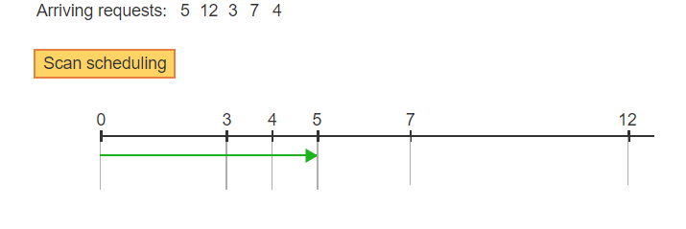
C Scan V.S. Scan Disk Scheduling – 2
While the r/w head is at track 5, new requests for tracks 12, 3, 7, and 4 arrive

Slide 38
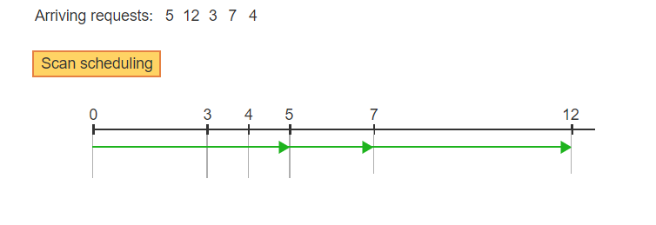
C Scan V.S. Scan Disk Scheduling – 3
Scan services the tracks in ascending order. The r/w head continues in the same direction to track 7, then to track 12

Slide 39
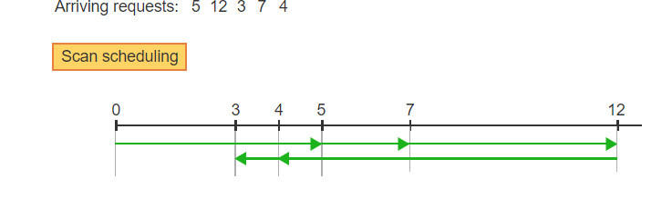
C Scan V.S. Scan Disk Scheduling – 4
Since no more requests exist past track 12, the r/w head reverses direction and services tracks 4 and 3 during a downsweep

Slide 40
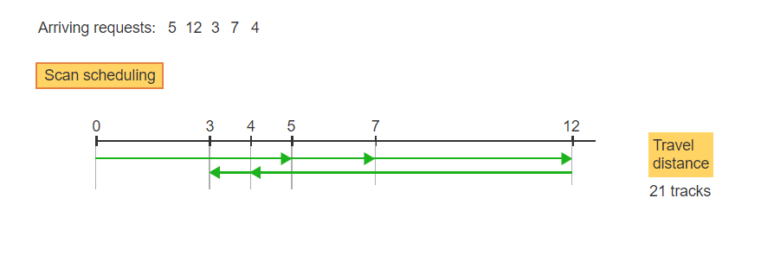
C Scan V.S. Scan Disk Scheduling – 5
The total travel distance of the r/w head is 5+2+5+8+1 = 21 tracks

Slide 41
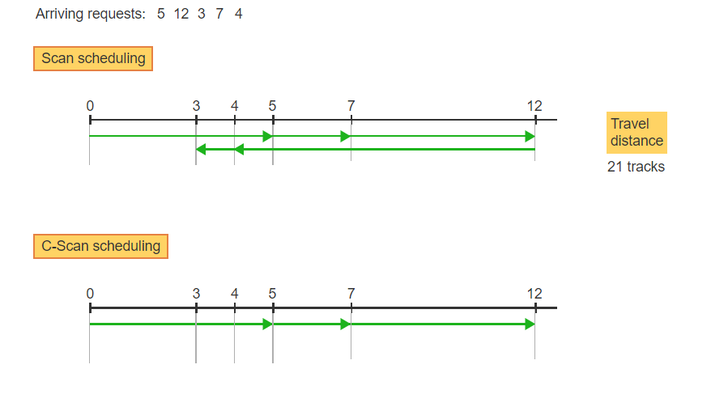
C Scan V.S. Scan Disk Scheduling – 6
C-Scan services all requests in only ascending order. As with Scan, the r/w head moves up to track 7, then track 12

Slide 42
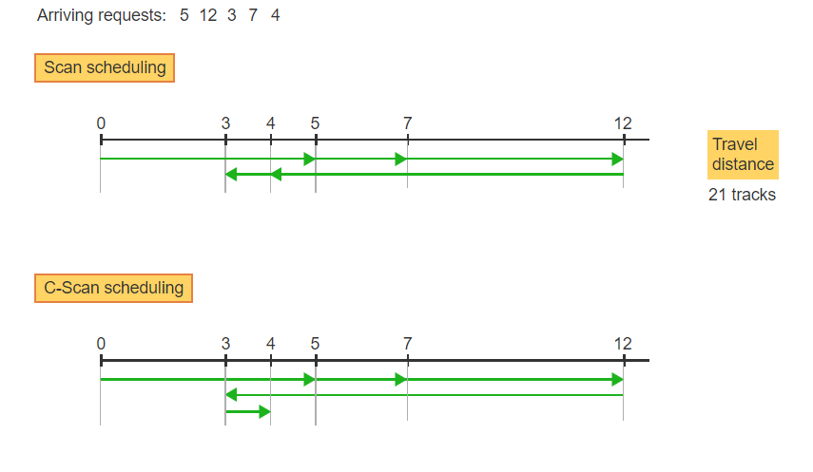
C Scan V.S. Scan Disk Scheduling – 7
The r/w arm then sweeps back without servicing any requests and starts a new upsweep, servicing first track 3, then track 4

Slide 43
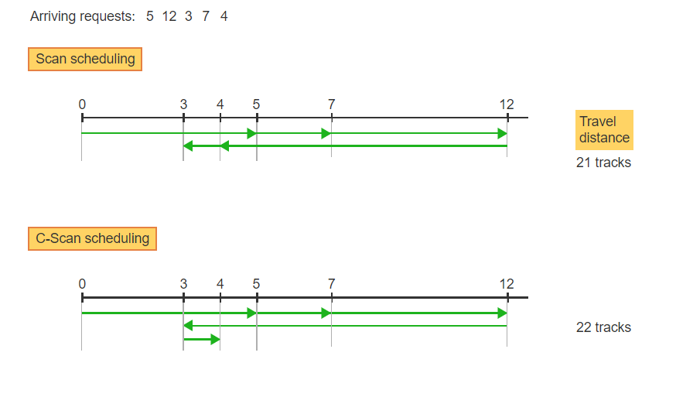
C Scan V.S. Scan Disk Scheduling – 8
The total travel distance of the r/w arm is 5+2+5+9+1 = 22 tracks

